Slide 1


West Africa Bank
2022 ATM Transactions Analysis Report

Slide 2

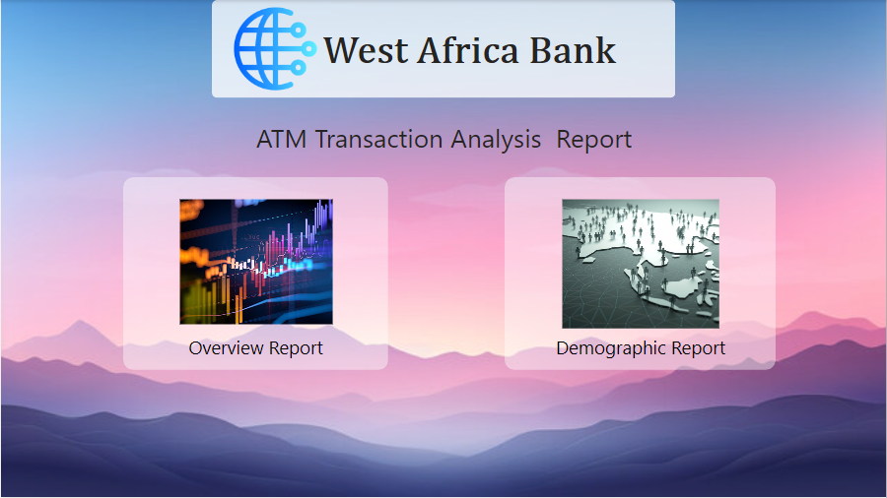
Home Page Home page consists of two Navigation Buttons.
Overview Report
Demographic Report

Slide 3
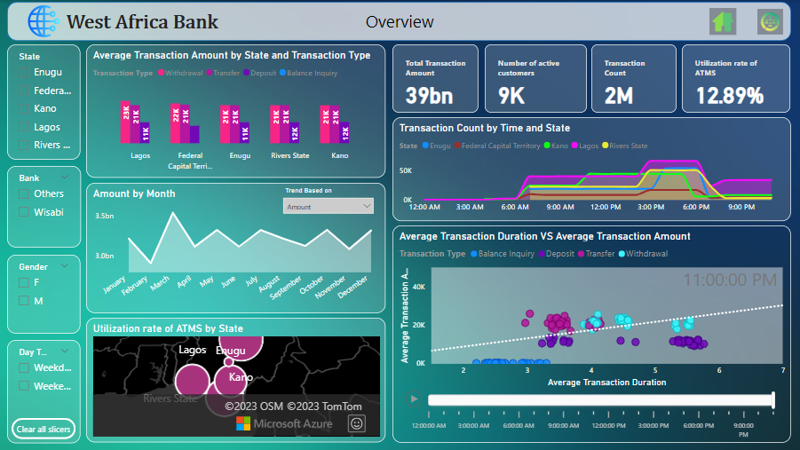
Overview Report
The West Africa Bank ATM Transaction Analysis Overview report provides a succinct overview of key insights, including transaction metrics, regional trends, and time series analysis. It facilitates efficient decision-making by presenting crucial information for stakeholders.

Slide 4
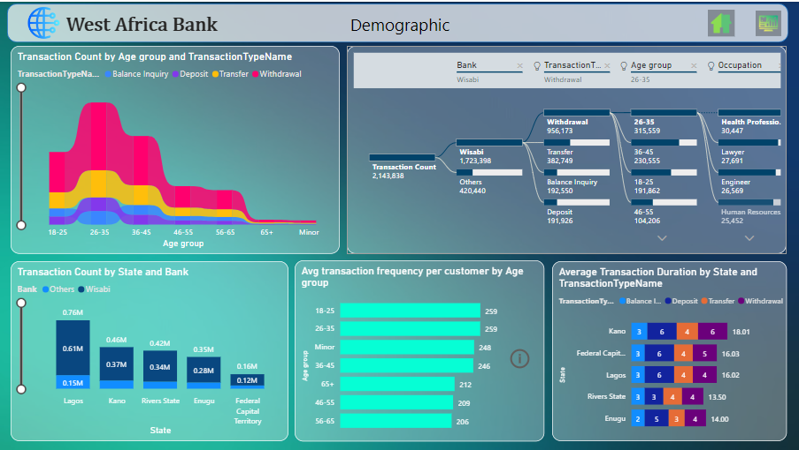
Demographic Report
The Demographic Report on West Africa Bank ATM Transactions offers a concise overview of transaction patterns, highlighting demographic insights, regional variations, and key trends.

Slide 5
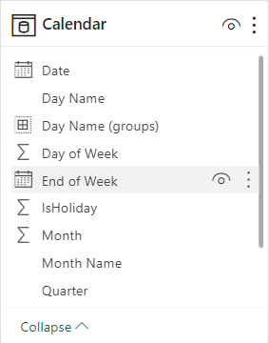
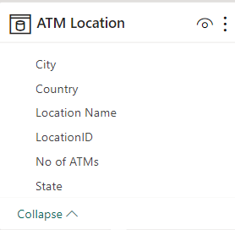
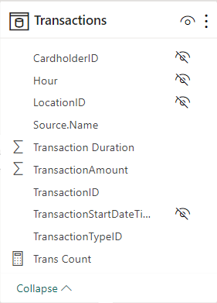
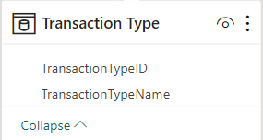
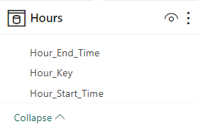
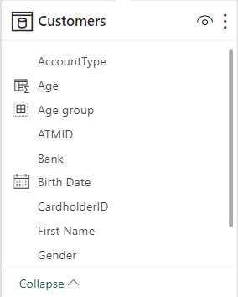
Data Model
The Data Model consists of 5 Fact Tables
Customers
ATM Locations
Transaction Type
Calendar
Hours
And 1 Data Table
Transactions

Slide 6

Report Overview:
₦38,555,885,000
Total amount processed by West Africa Bank ATMs in 2022
2,143,838
Number of Transactions Processed
8819
Unique persons who carried out at least one transaction
12.9%
Utilization Rate

Slide 7
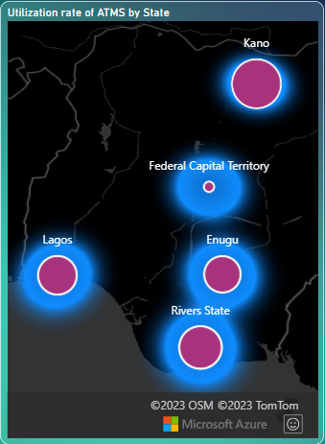

Utilization Rate
DAX
ATMs in Kano have the highest Utilization Rate (18.6%)
Rivers & Lagos have Utilization Rates greater than 12% (12.7% & 12.2% respectively) while that for Enugu is 11.6%
The FCT has the lowest Utilization Rate (8.5%)

Slide 8
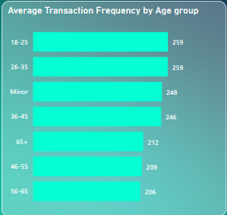
Transaction Frequency
Customers between 18-25 years and 26-35 years have the highest transaction frequency (259).
Interestingly, customers above 65 years have a higher transaction frequency (216) than the 56 - 65 & 46 - 55 age groups (209 & 206 respectively).

Slide 9
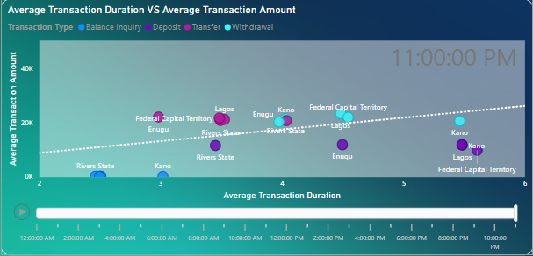
Average Amount vs Average Duration Correlation Analysis
On an average, Withdrawal and Deposit took the highest average transaction duration (5min<Duration<6min).
Whereas transfer and withdrawal transacted highest average transaction Amount (21K<Amount<24K).
Kano also has the longest transaction duration for Balance Inquiries and Transfers
Kano, Lagos, and the FCT have longer transaction duration for Deposits (>5 mins) while Rivers has the lowest transaction duration for deposits.(<4 mins)

Slide 10
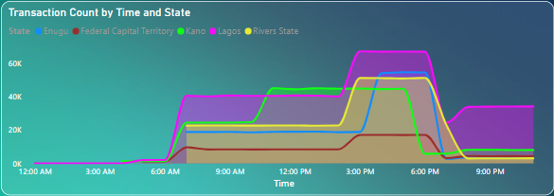
Daily Transaction Trend
ATM Transactions in Lagos increase gradually from 6 am and peaks between 3 and 7 pm.
Similar behavior is seen across other states however transactions peak earlier in Kano (around 11 am) and this is sustained till about 5 pm after which activity sharply declines.
Compared to other states, Lagos has significant transactions activity after 7 pm.

Slide 11
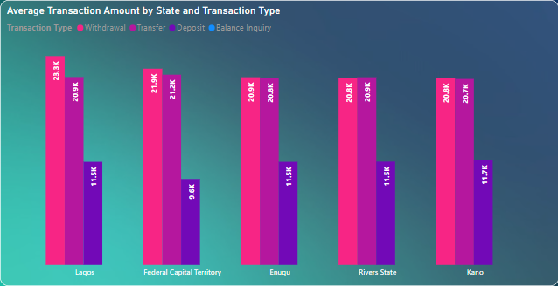
Average Transaction Amount
On Average, Withdrawals have the highest transaction amounts across all states, next is Transfers, with Deposits have the lowest.
Across all locations, The FCT has comparatively lower Deposit amounts on Average (9.6K)
There is no amount associated with Balance Enquiry, Therefore it did not project in the graph.

Slide 12
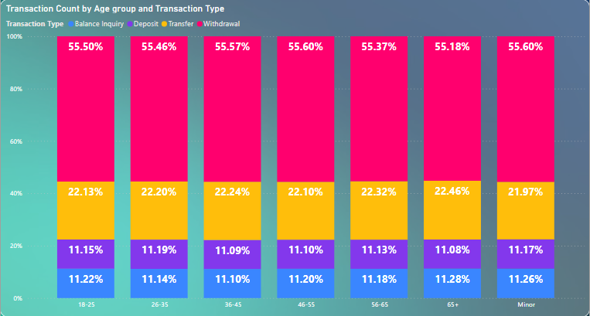
Transaction Count
Across all Age Groups, Withdrawals is the common transaction type (>50%), followed by Transfers (>20%)
Interestingly, Deposits & Transfers account for a significant amount of transaction (>10% each) across all Age Groups

Slide 13
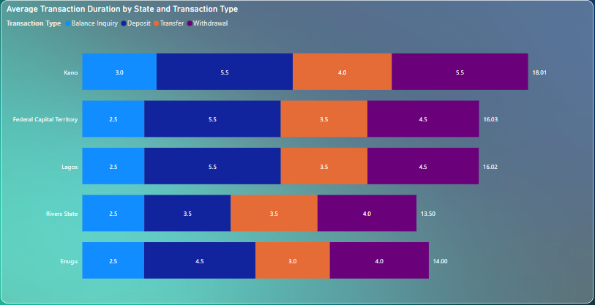
Average Transaction Duration
Across all locations, Withdrawals has the longest duration on average.
Kano’s average Withdrawal, Transfer, and Balance Inquiry durations are comparatively higher than other locations.
Rivers & Enugu have lower average transaction duration for Deposits, Transfers, & Withdrawals when compared to other locations.

Slide 14
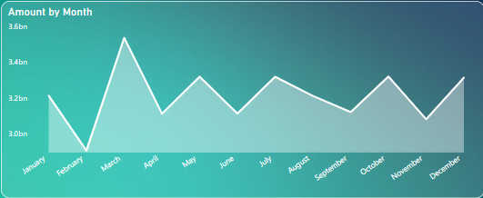
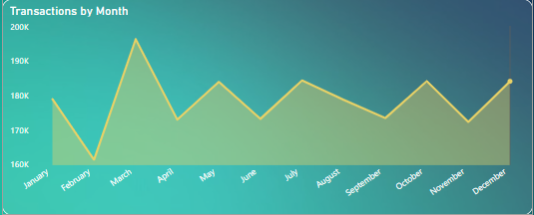
Trends of Transaction Amount and Count
We had the highest number of transactions and transaction amount in March
Other months with high transaction activity include January, May, July, October, and December
We had the lowest number of transactions and transaction amount in February

Slide 15
Recommendations
Utilization rate in the FCT is comparatively low. Possible solutions to remedy this include:
Make sure that the ATMs are visible and accessible to customers. This could involve relocating the ATMs to more prominent locations, installing signage, or improving lighting and landscaping around the ATMs.
Offer incentives to customers such as waived transaction fees or cashback rewards.
Use various marketing channels to promote the availability and convenience of the ATM to customers, such as through social media, email newsletters, or in-branch promotions.
Consider offering additional services at the ATM, such as the ability to deposit checks or make cash withdrawals in different denominations.
Conduct surveys or use customer analytics to understand the preferences and habits of customers who use the ATM, and tailor the ATM's services and features to better meet their needs.

Slide 16
Recommendations
Average Transaction Duration in Kano is longer when compared to other locations. Possible solutions to remedy this include:
Consider upgrading the ATMs to newer models with faster transaction times and more advanced features. This can improve the overall experience for customers using the ATM and may encourage them to use it more often.
Ensure that the ATMs are regularly serviced and maintained to prevent downtime and minimize technical issues that can contribute to longer transaction times.
Analyze transaction data to identify bottlenecks or issues that may be contributing to longer transaction times. This could involve looking at patterns of usage, common user errors, or technical issues that may be slowing down the process.
Provide customers with education on how to use the ATM more efficiently, such as by highlighting common errors to avoid or offering guidance on how to complete transactions more quickly.

Slide 17
Recommendations
A significant proportion of transactions (>20%) are either Balance Enquiries or Transfers. Possible solutions to remedy this include:
Provide customers with education on alternative banking channels such as phone banking or online banking, highlighting the benefits of these channels and how to use them effectively. This could involve providing brochures or other materials in the branch, as well as online resources and tutorials.
Consider offering incentives to customers who use alternative banking channels, such as waiving transaction fees or offering cashback rewards. This can encourage customers to try these channels and may help to shift usage away from the ATM.
Ensure that the phone banking process is simple and straightforward for customers to use, with clear instructions and minimal waiting times.
Continue to monitor customer behavior and analyze usage data to identify areas where usage of alternative banking channels can be improved.

Slide 18
Recommendations
Transactions Activity:
ATMs have significantly reduced activity in the early and late hours of the day (Before 5 am & After 8 pm). Lagos is the only exception as there is still noticeable activity after 8 pm.
Scheduled maintenance should coincide with these periods of reduced activity.
Additionally, ATMs should have maximum availability especially during the peak activity periods for each bank branch.

Slide 19

Thank You
Please Follow
For more Such Projects

